Slide 1
Decision Tree Ensembles: Bagging and Boosting

Slide 2
Introduction to Model Ensemble
Basic Idea:
Instead of Learning only one model, learn several and combine them
Improves Accuracy by a high amount mainly due to Bias-Variance Trade-off
Examples of Decision Tree Ensembles:
Bagging
Random Forest
Boosting
Stacking
etc.

Slide 3
Disadvantages of Decision Tree
Individual decision tree suffers from
1. Instability
2. High Variance
Together, Accuracy is lower in a single decision tree
Hence rise of decision tree ensembles of using multiple learners .
Accuracy gets improved by bias-variance tradeoff

Slide 4
How an ensemble classifier works?
Input Features
Classifier 1
Classifier 2
Classifier 3
Classifier N
…….
Class Predictions
Combiner/Aggregator (Majority Voting Decision)
Final Class Prediction
Next: Discussion on Bias-Variance Tradeoff in Machine Learning

Slide 5
Decision Tree Ensembles: Bagging and Boosting
Bias-Variance Tradeoff in Machine Learning
It is generally observed that
–models with too few parameters can perform poorly
–models with too many parameters can perform poorly
•Need to optimize the complexity of the model to achieve the best performance
•One way to get insight into this tradeoff is the decomposition of generalization error into bias and variance
–a model which is too simple, or too inflexible, will have a large bias
–a model which has too much flexibility will have high variance

Slide 6
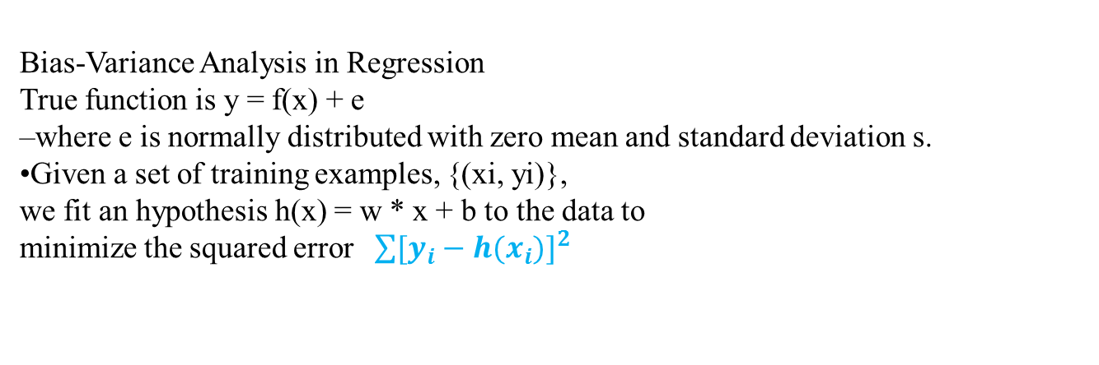
Intuition
Bias:
–measures the accuracy or quality of the algorithm
–high bias means a poor match
Variance:
–measures the precision or specificity of the match
–a high variance means a weak match
•We would like to minimize each of these
•Unfortunately, we can’t do this independently, there is a trade-off
Bias-Variance Analysis in Regression
True function is y = f(x) + e
–where e is normally distributed with zero mean and standard deviation s.
•Given a set of training examples, {(xi, yi)},
we fit an hypothesis h(x) = w * x + b to the data to
minimize the squared error $\sum{[y_{i}}−h(x_{i})]^{2}$

Slide 7
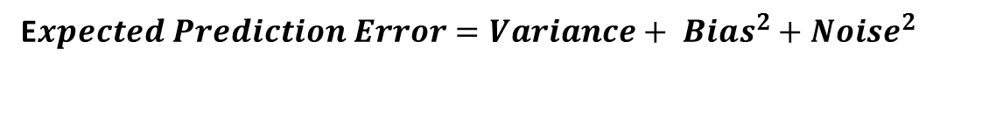
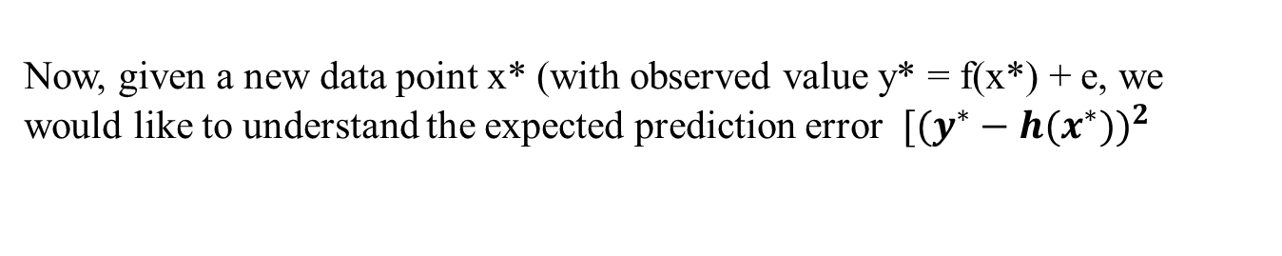
Decision Tree Ensembles: Bagging and Boosting
Now, given a new data point x* (with observed value y* = f(x*) + e, we would like to understand the expected prediction error $[(y^{∗}−h(x^{∗}{))}^{2}$
We can Decompose this into “bias”, “variance”, and “noise”
E$xpected Prediction Error=Variance+ {Bias}^{2}+{Noise}^{2}$

Slide 8
Decision Tree Ensembles: Bagging and Boosting
Example of Bias
Low bias
–linear regression applied to linear data
–2nd degree polynomial applied to quadratic data
•High bias
–constant function
–linear regression applied to non-linear data
Example of Variance
•Low variance
–constant function
–model independent of training data
•High variance
–high degree polynomial

Slide 9
Decision Tree Ensembles: Bagging and Boosting
Prediction Accuracy is determined by the combination of Bias & Variance
Often it is observed that:
–low bias => high variance
–low variance => high bias
Tradeoff:
–bias vs. variance

Slide 10
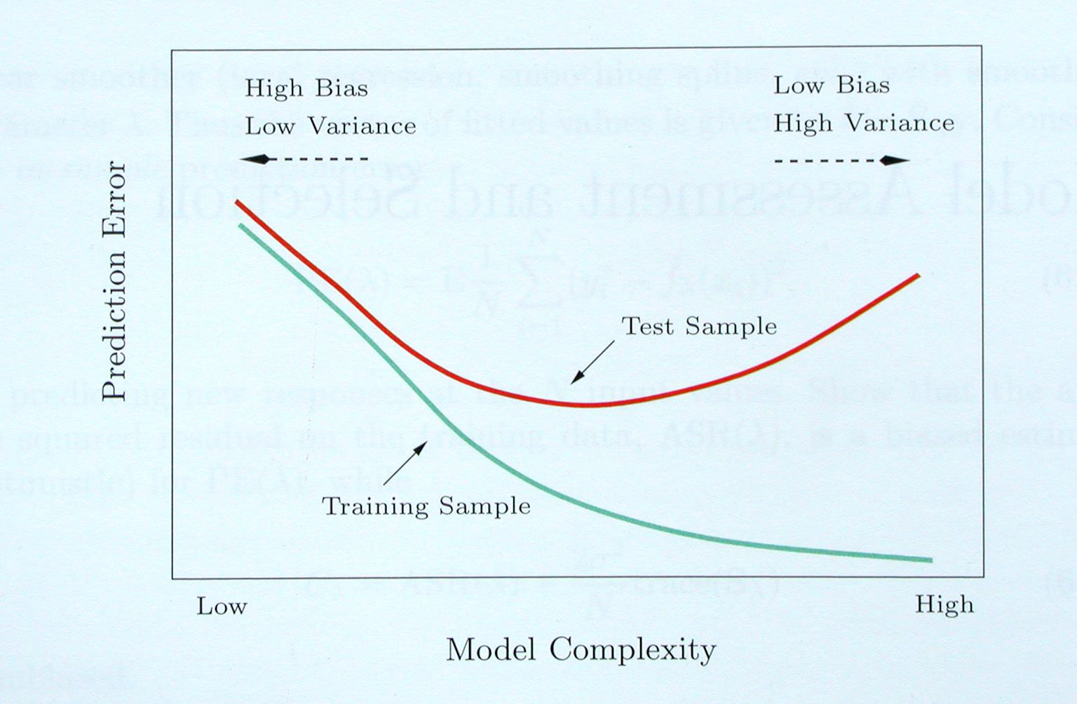
Decision Tree Ensembles: Bagging and Boosting
Hastie, Tibshirani, Friedman “Elements of Statistical Learning” 2001

Slide 11
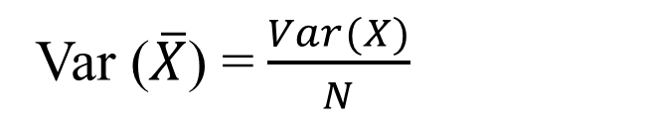
Decision Tree Ensembles: Bagging and Boosting
Reduce Variance Without Increasing Bias
• Averaging reduces variance:
Average models to reduce model variance
Var ($\overline{X}$) =$\frac{Var(X)}{N}$

Slide 12
Bagging: Bootstrap Aggregation
•Leo Breiman (1994)
•Take repeated bootstrap samples from training set D.
•Bootstrap sampling: Given set D containing N training examples, create D’ by drawing N examples at random with replacement from D.
•Bagging:
–Create k bootstrap samples D1 … Dk.
–Train distinct classifier on each Di.
–Classify new instance by majority vote / average.

Slide 13
When Will Bagging Improve Accuracy?
•Depends on the stability of the base-level classifiers.
•A learner is unstable if a small change to the training set D causes a large change in the output hypothesis
–If small changes in D causes large changes  in then there will be an improvement in performance.
•Bagging helps unstable procedures, but could hurt the performance of stable procedures.
•Neural nets and decision trees are unstable.
•k-nn and naïve Bayes classifiers are stable.

Slide 14
How we can Reduce Bias and Decrease Variance?
•Bagging reduces variance by averaging
•Bagging has little effect on bias
•Can we average and reduce bias?
•Yes: By Using Boosting

Slide 15
Boosting
•Freund & Schapire:
–theory for “weak learners” in late 80’s
•Weak Learner: performance on any train set is slightly better than chance prediction
•intended to answer a theoretical question, not as a practical way to improve learning
•tested in mid 90’s using not-so-weak learners
•works anyway!

Slide 16
Boosting
•Weight all training samples equally
•Train model on training set
•Compute error of model on training set
•Increase weights on training cases model gets wrong
•Train new model on re-weighted training set
•Re-compute errors on weighted training set
•Increase weights again on cases model gets wrong
•Repeat until tired (100+ iterations)
•Final model: weighted prediction of each model

Slide 17
Summary: Boosting vs. Bagging
•Bagging doesn’t work so well with stable models. Boosting might still help.
•Boosting might hurt performance on noisy datasets. Bagging doesn’t have this problem.
•On average, boosting helps more than bagging, but it is also more common for boosting to hurt performance.
•Bagging is easier to parallelize.

